Slide 1
Calculus 2 Introduction
What is this Calculus 2?
Why bother?

Slide 2
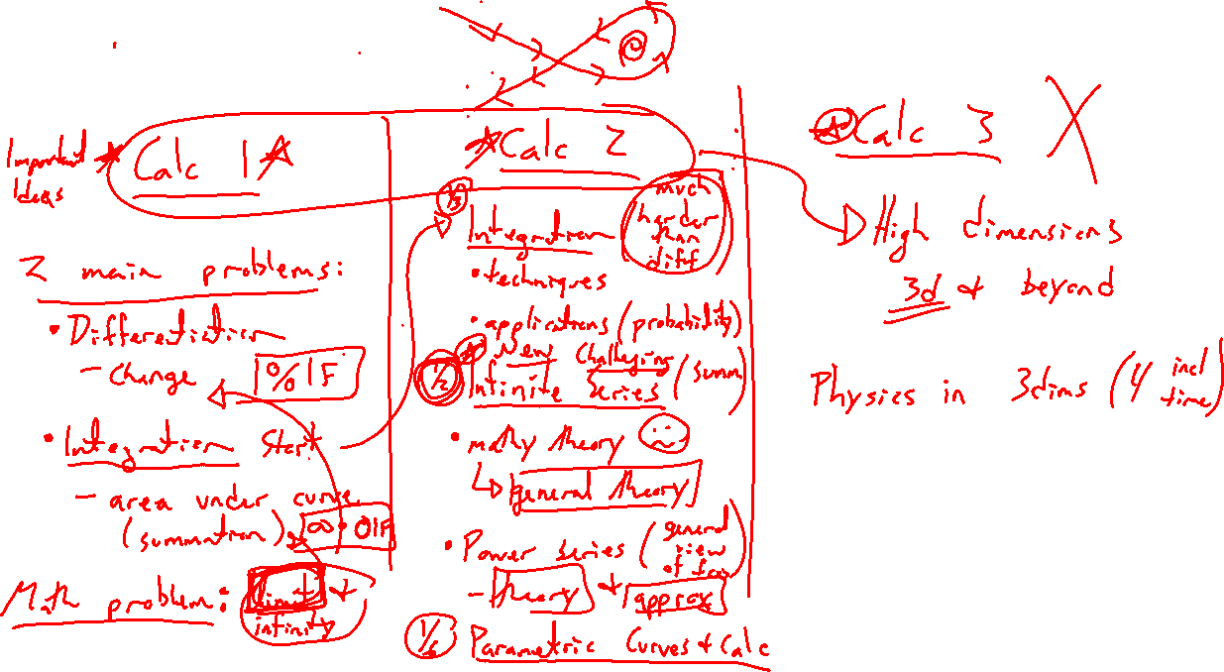
All the Calculuses
Notes:
Calc 1: Derivative and integral, fundamental question of indeterminnant form
Calc 2: Finish integration, infinite series / power series big new idea
Calc 3: Extension to 3+ dimensional space

Slide 3
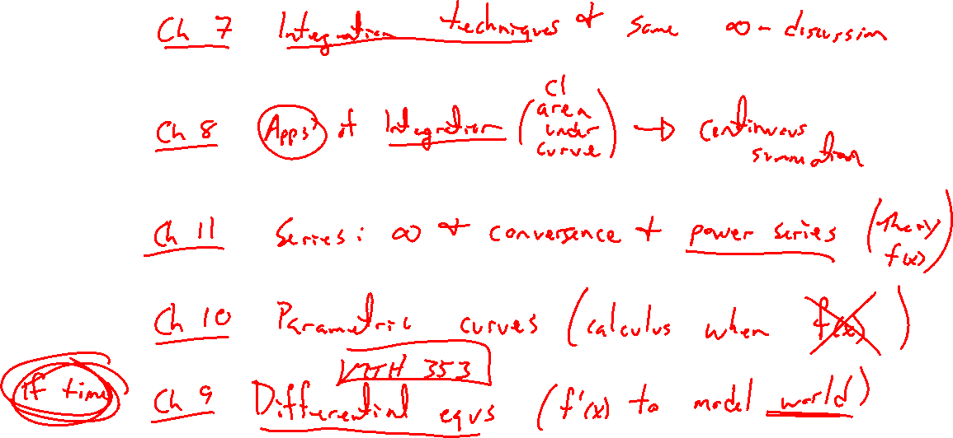
Calculus 2 Contents
Notes:
Integration (techniques, applications)
Series (important theory conversation, power series huge take-away)
Parametric equations (generalize beyond functions to any curve)

Slide 4
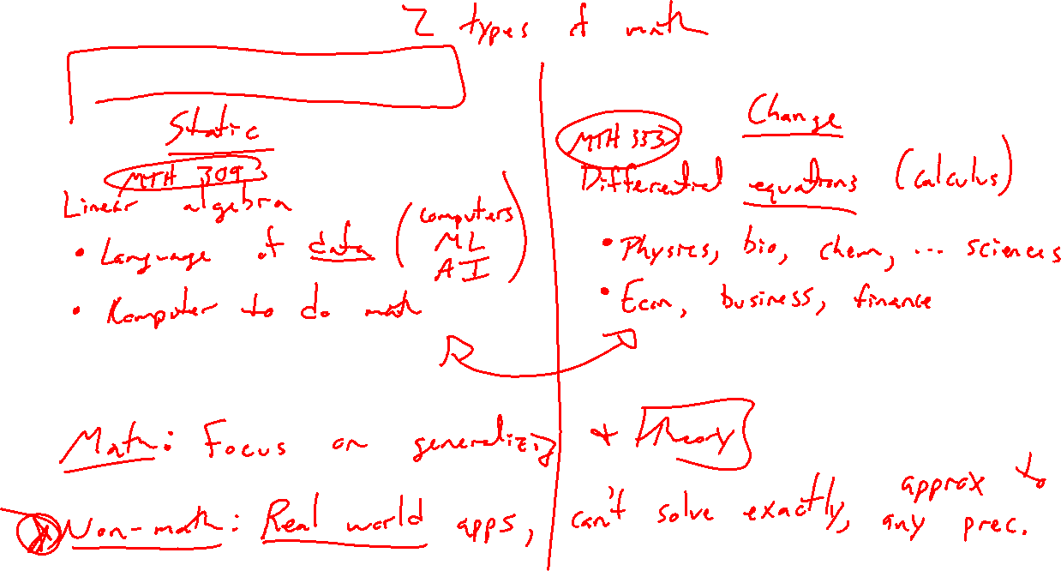
Life After Calculus
Notes:
Static (linear algebra, data)
vs
Change (differential equations, laws of physics, bio, econ)
- math majors deep dive into theory
- real world applications involve approximation and computers

